Slide 1
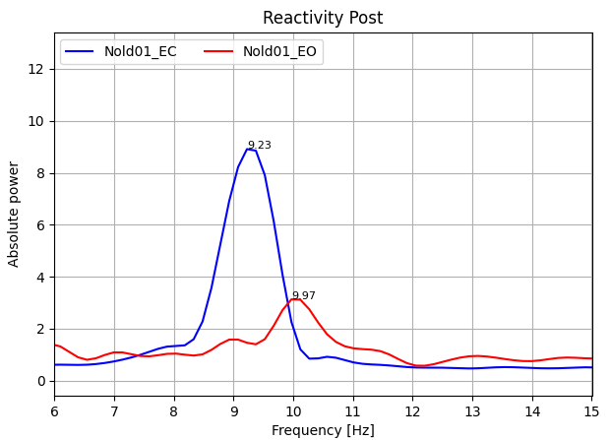
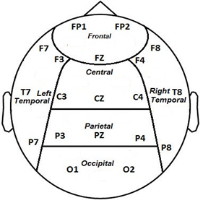
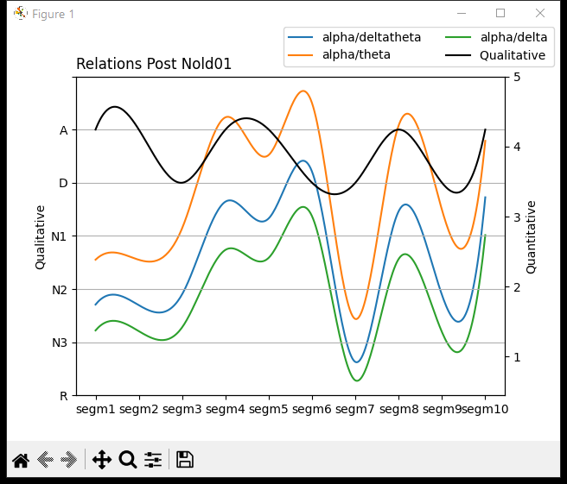
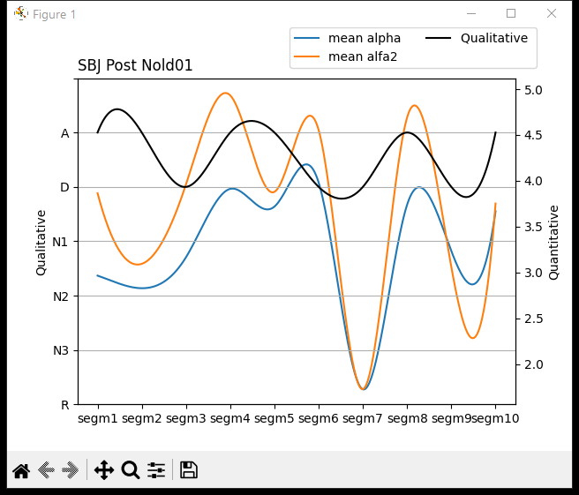
Nold01
CPO
TF | IAF
5,5 | 8,5
5,5 | 10
6,5 | 10
6 | 10
6,5 | 9,5
5,5 | 9,5
5,5 | 9,5
6,5 | 10
5,5 | 9,5
6,5 | 9,5
6 | 10
This graph represents the reactivity of the Nold01 subject taking the recording of the signal in the resting state.

Slide 2
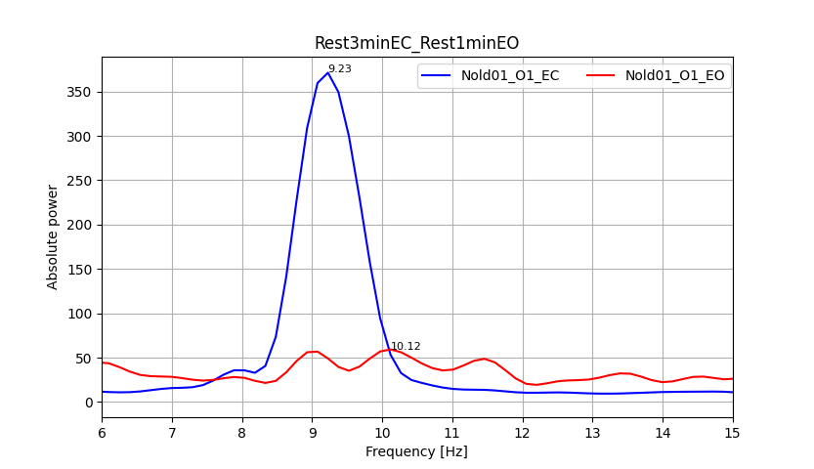
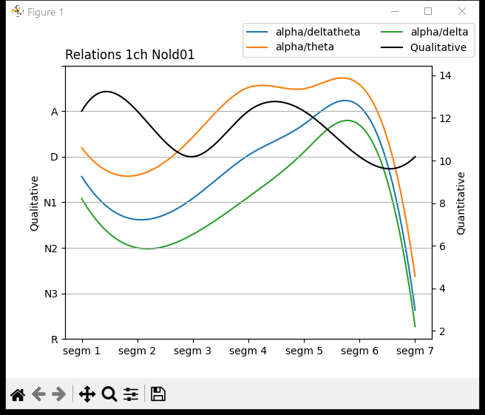
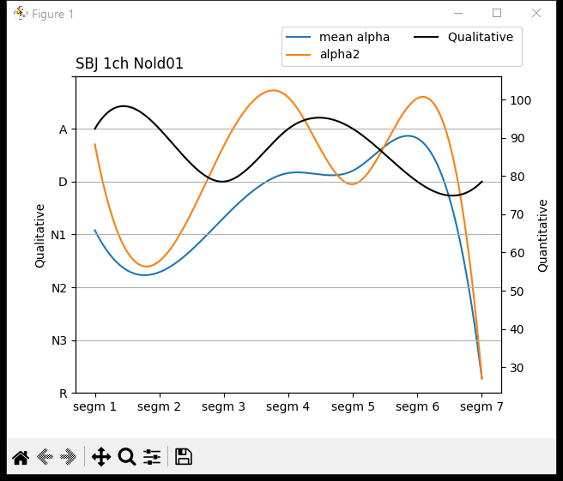
Nold01
This graph represents the channel with best reactivity of the Nold01 subject taking the signal recording in the resting state for eyes open and the signal recording in the resting state for eyes closed.

Slide 3
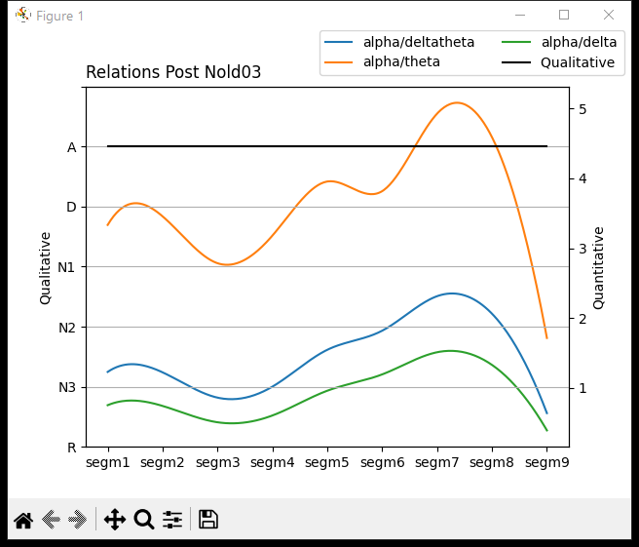
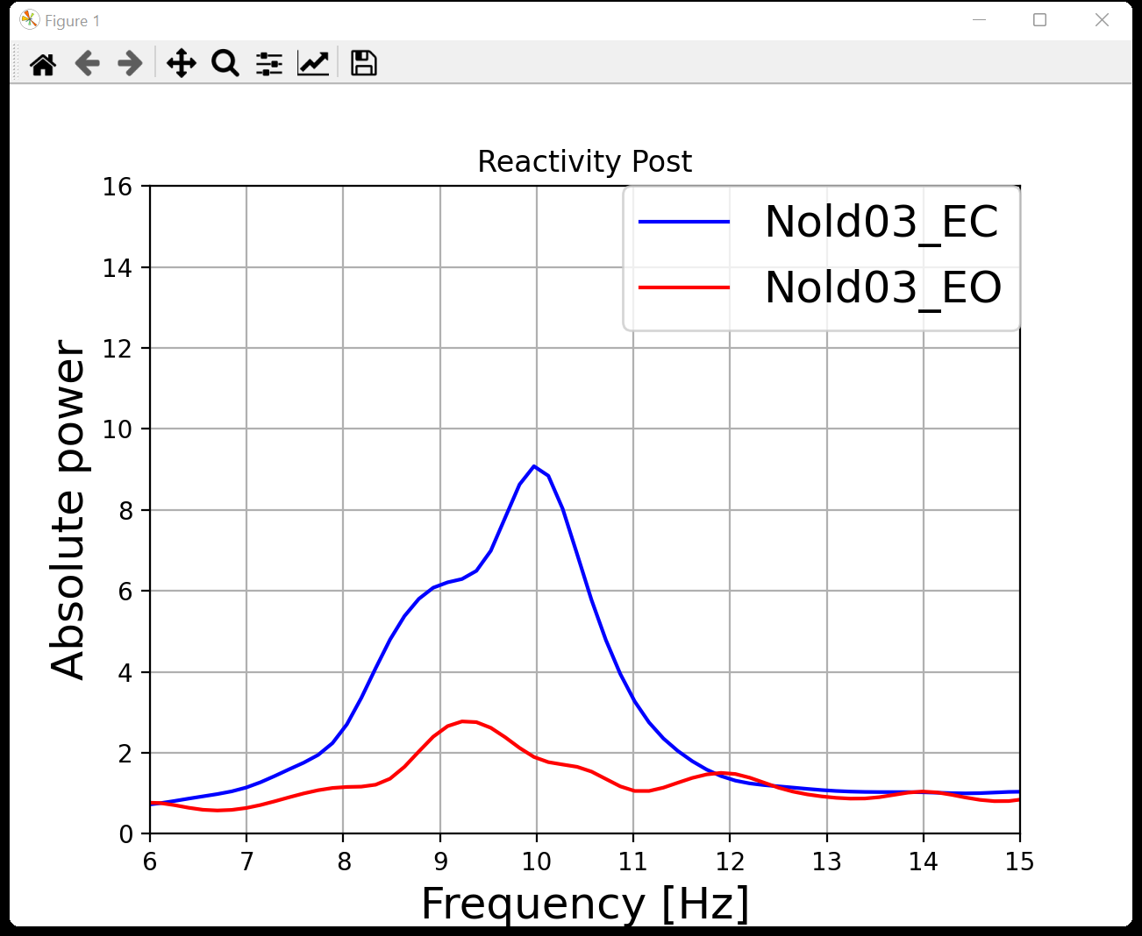
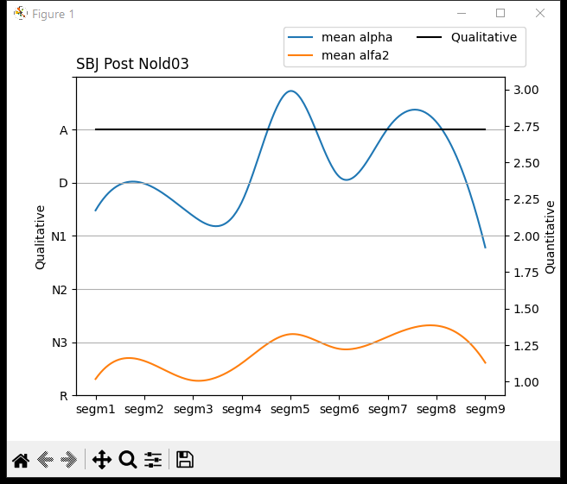
Nold03
CPO
TF | IAF
5 | 10
5 | 10,5
4,5 | 10
5 | 10
5 | 10,5
5,5 | 10
5,5 | 10
5,5 | 10
4 | 10
5 | 10
This graph represents the reactivity of the Nold03 subject taking the recording of the signal in the resting state.

Slide 4
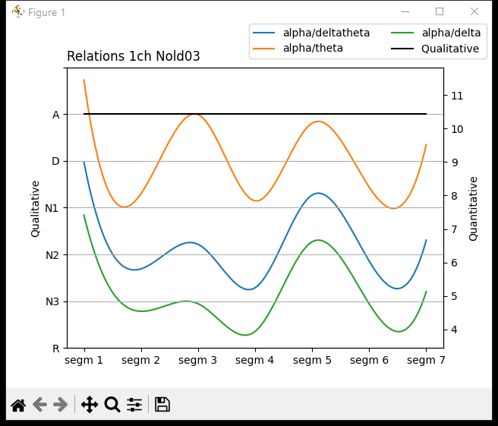
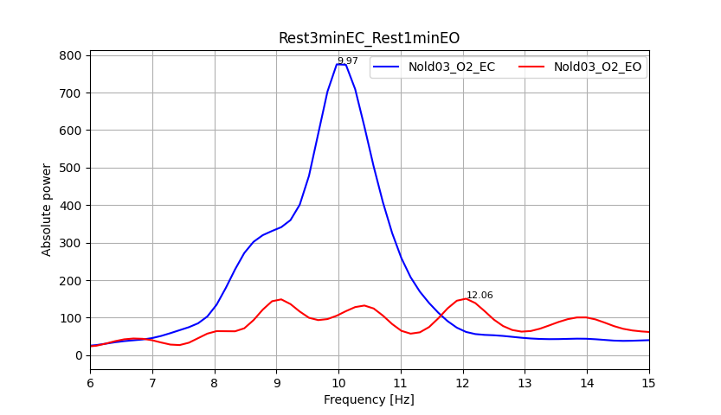
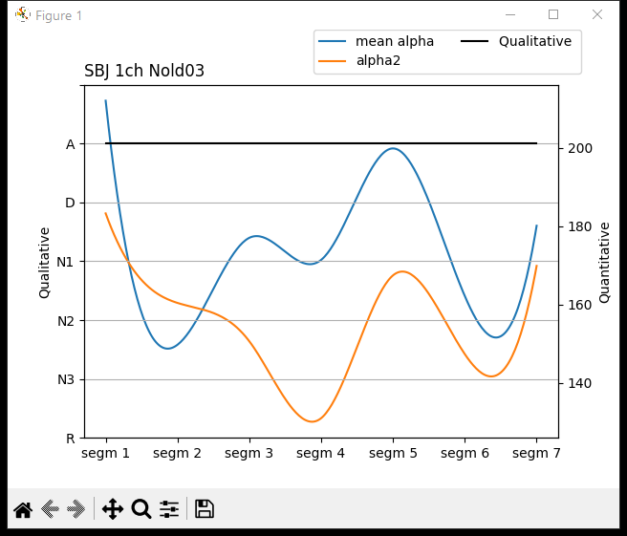
Nold03
This graph represents the channel with best reactivity of the Nold03 subject taking the signal recording in the resting state for eyes open and the signal recording in the resting state for eyes closed.

Slide 5
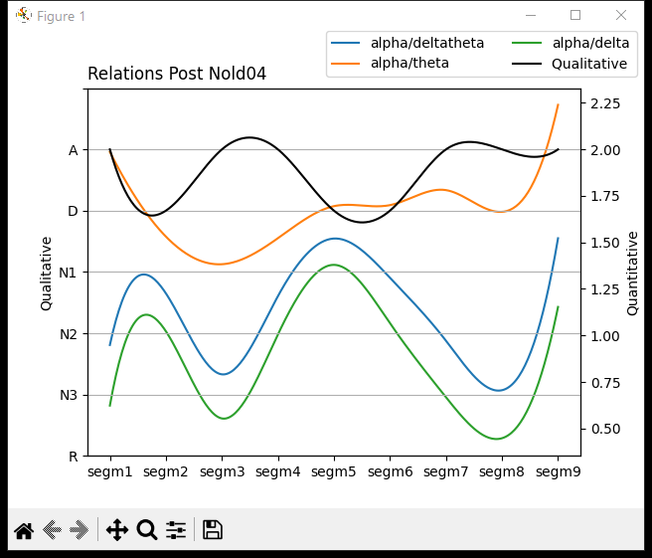
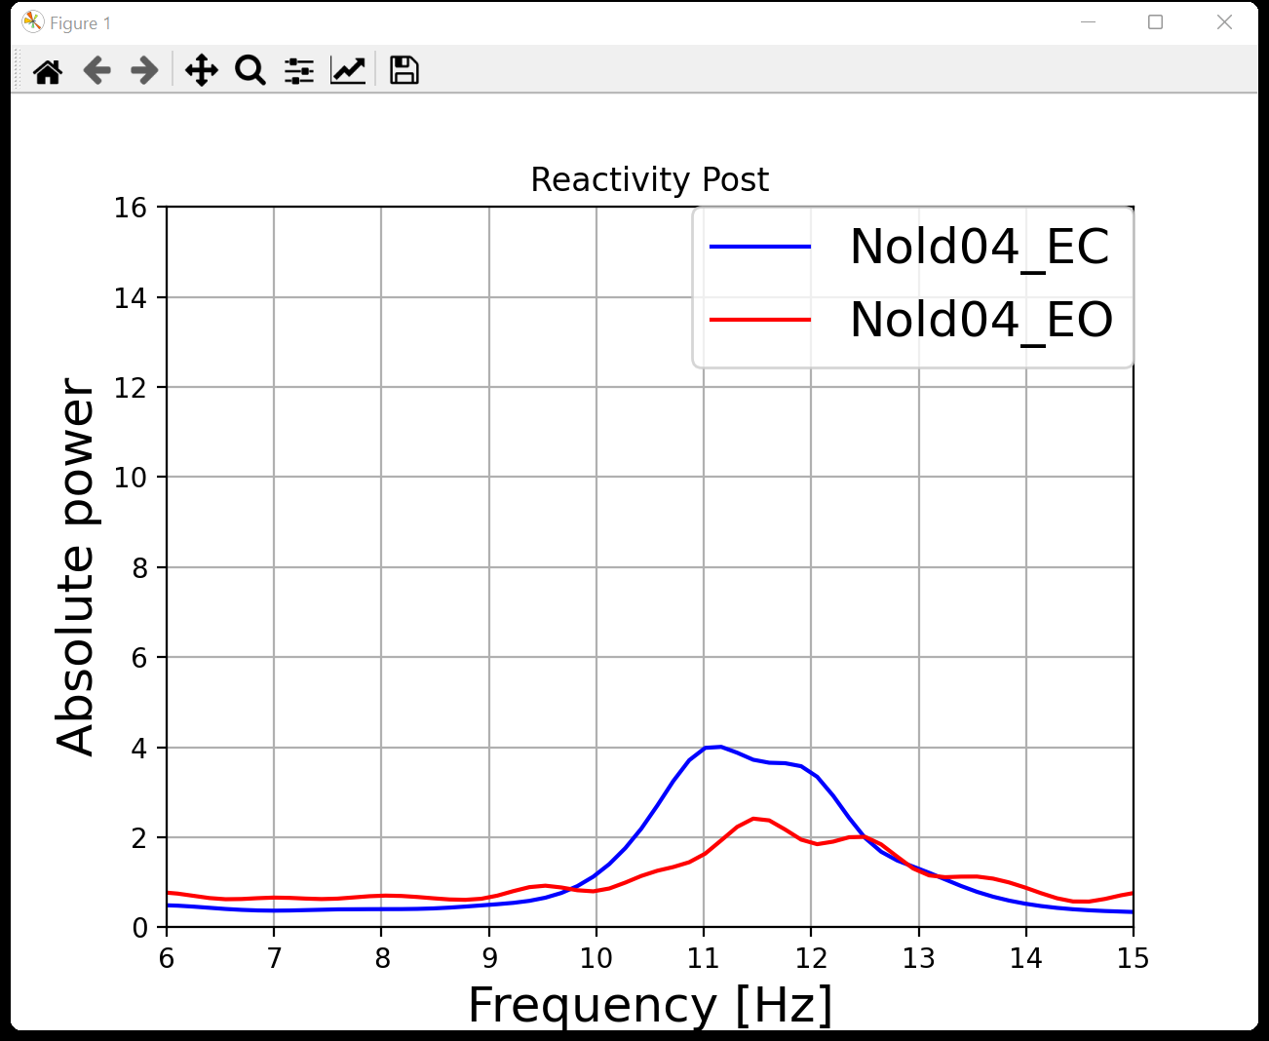
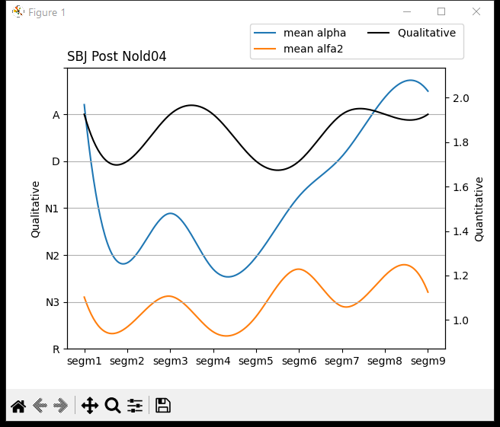
Nold04
CPO
TF | IAF
5,5 | 11,5
6,5 | 11,5
5,5 | 12
6,5 | 11,5
7,5 | 11,5
6,5 | 11,5
5,5 | 11,5
5 | 11
6 | 11,5
7 | 11
This graph represents the reactivity of the Nold04 subject taking the recording of the signal in the resting state.

Slide 6
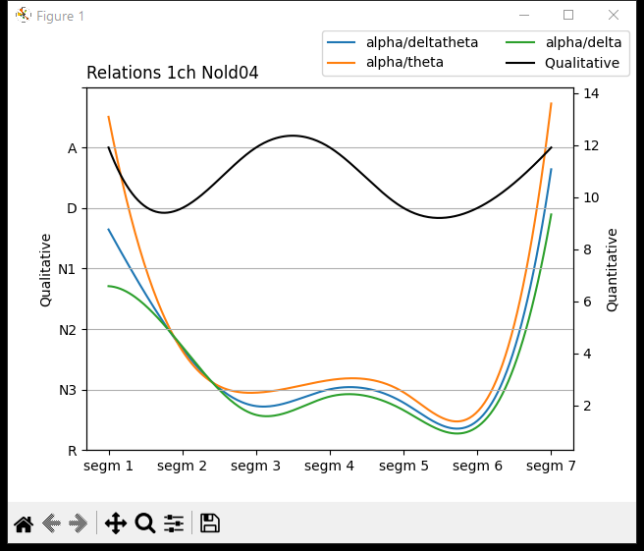
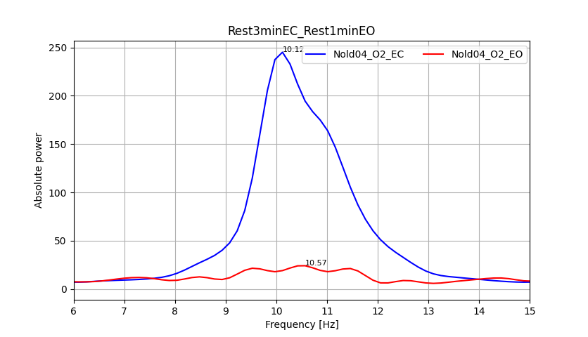
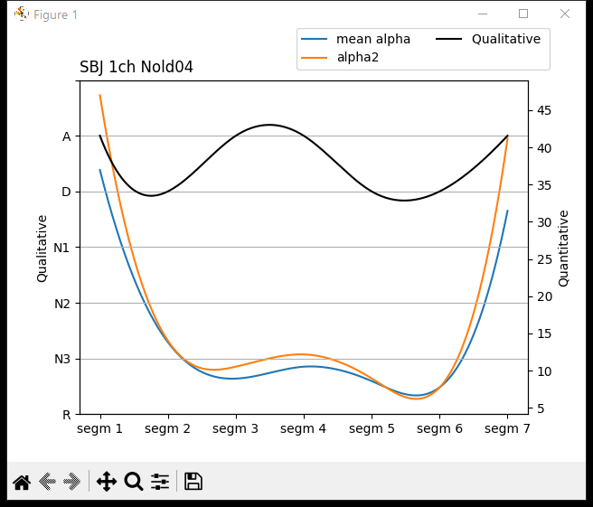
Nold04
This graph represents the channel with best reactivity of the Nold04 subject taking the signal recording in the resting state for eyes open and the signal recording in the resting state for eyes closed.

Slide 7
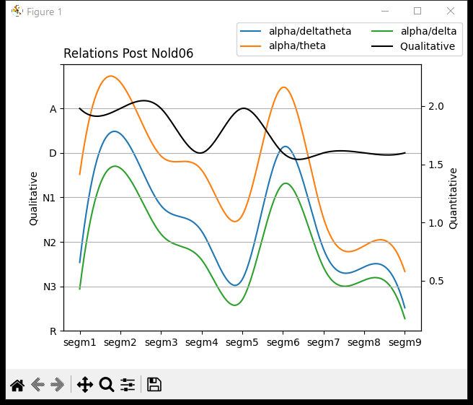
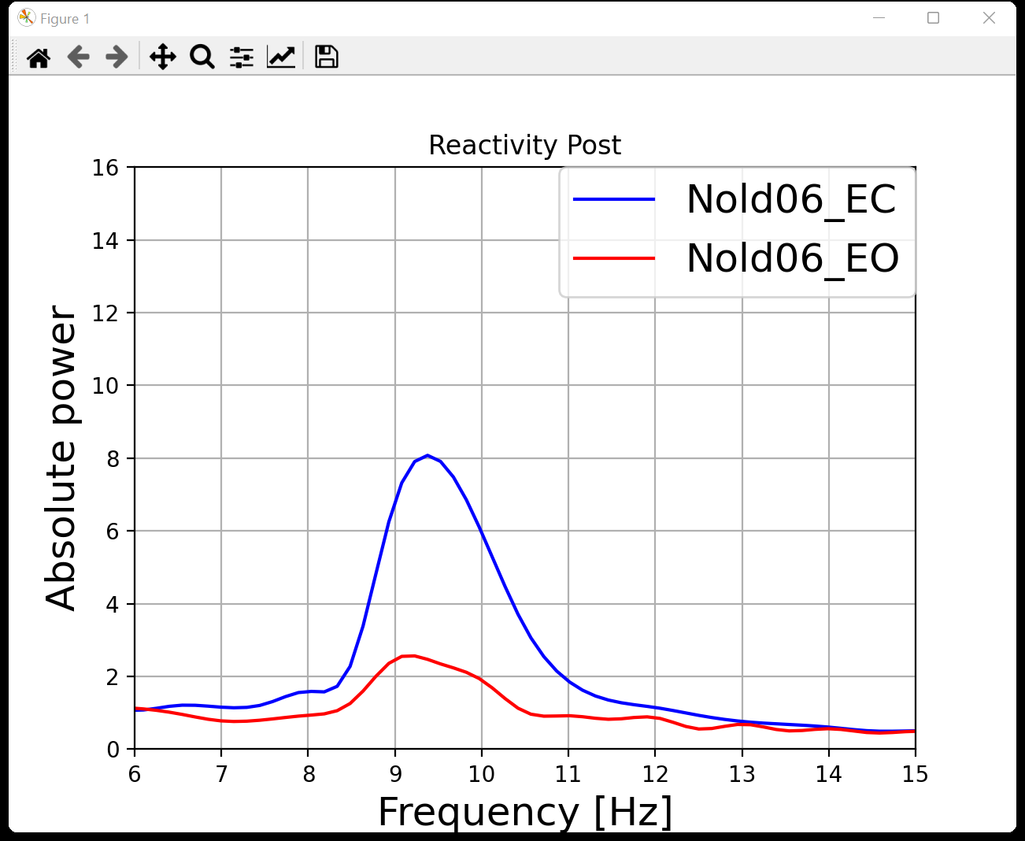
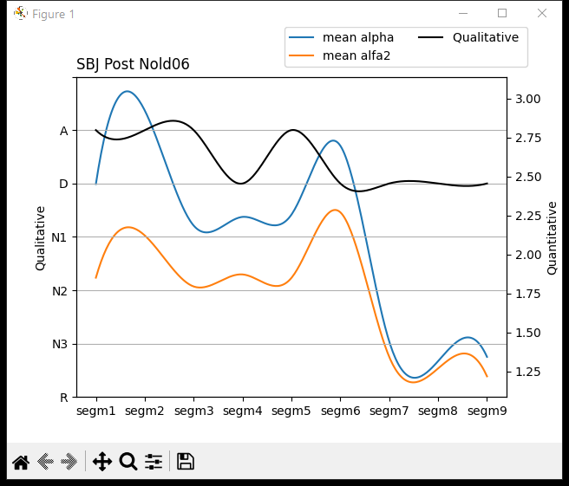
Nold06
CPO
TF | IAF
5 | 9
6,5 | 9
6 | 8,5
5,5 | 9
4,5 | 9
6,5 | 9
6,5 | 9
6,5 | 9
5 | 9
4,5 | 8,5
This graph represents the reactivity of the Nold06 subject taking the recording of the signal in the resting state.

Slide 8
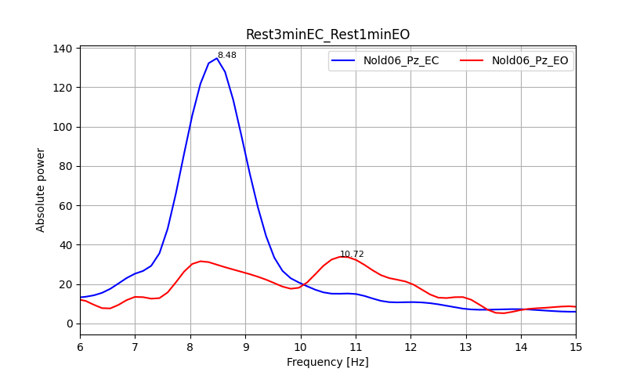
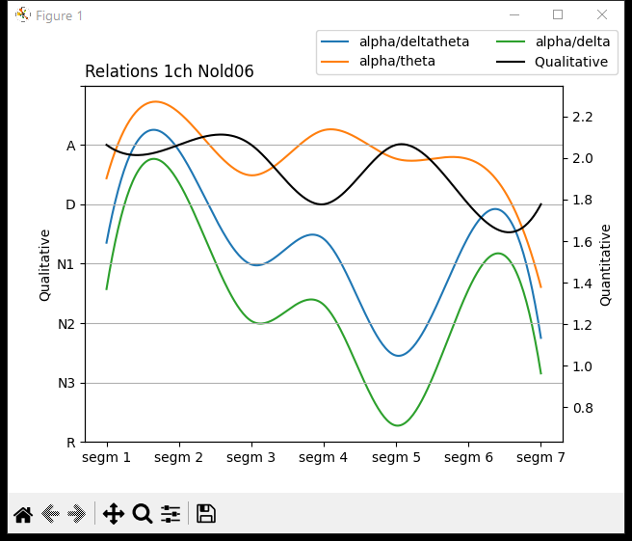
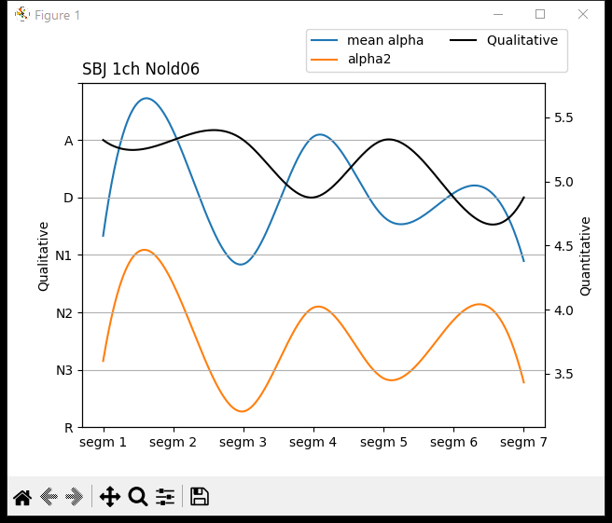
Nold06
This graph represents the channel with best reactivity of the Nold06 subject taking the signal recording in the resting state for eyes open and the signal recording in the resting state for eyes closed.

Slide 9
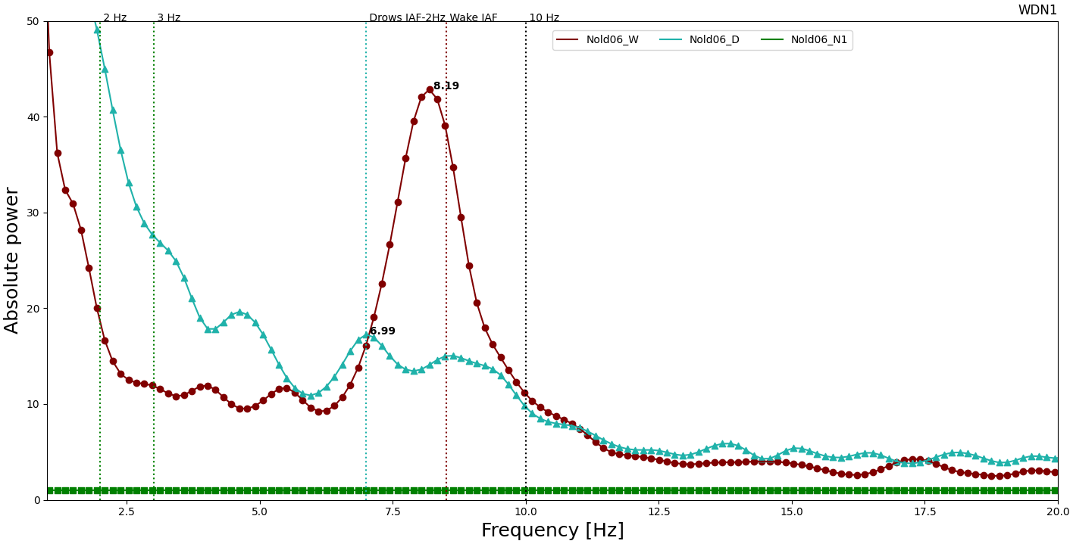
Nold06

Slide 10
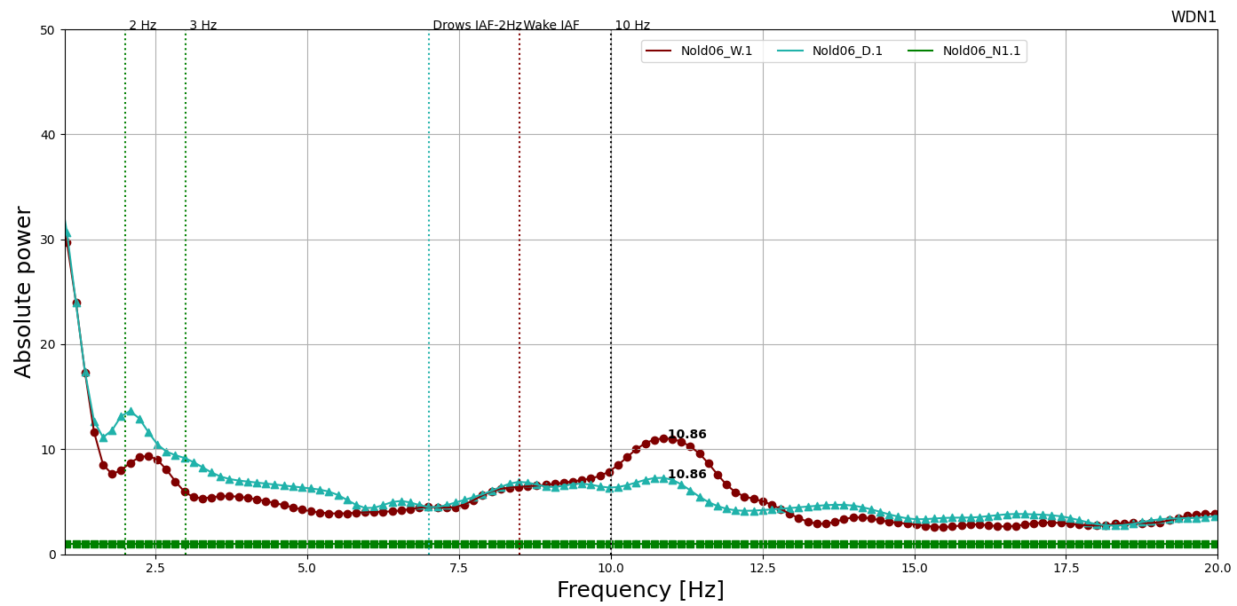
Nold06

Slide 11
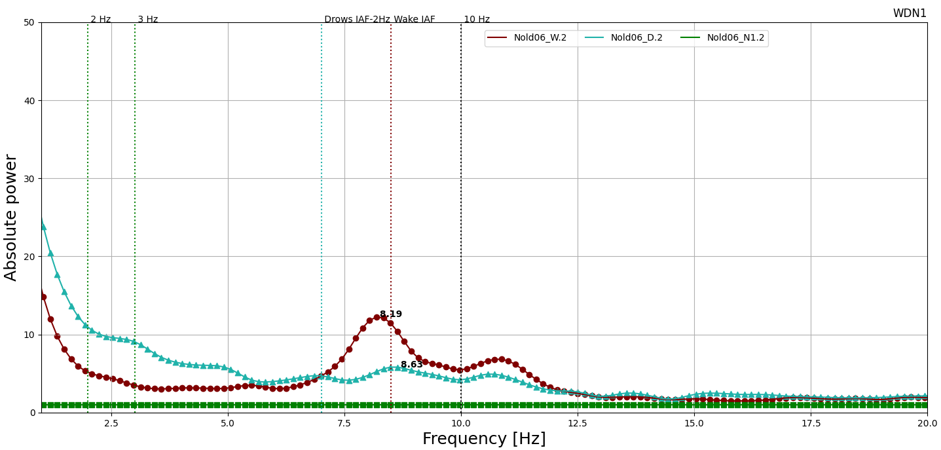
Nold06

Slide 12
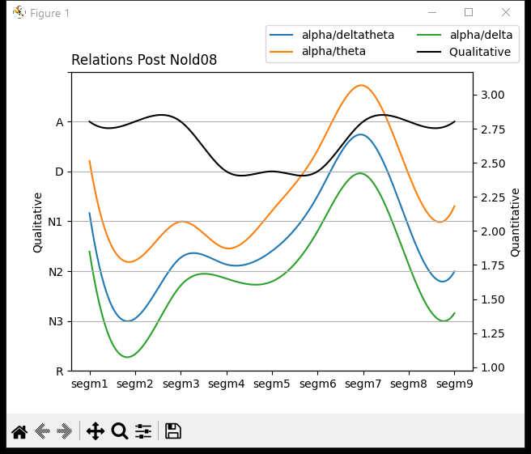
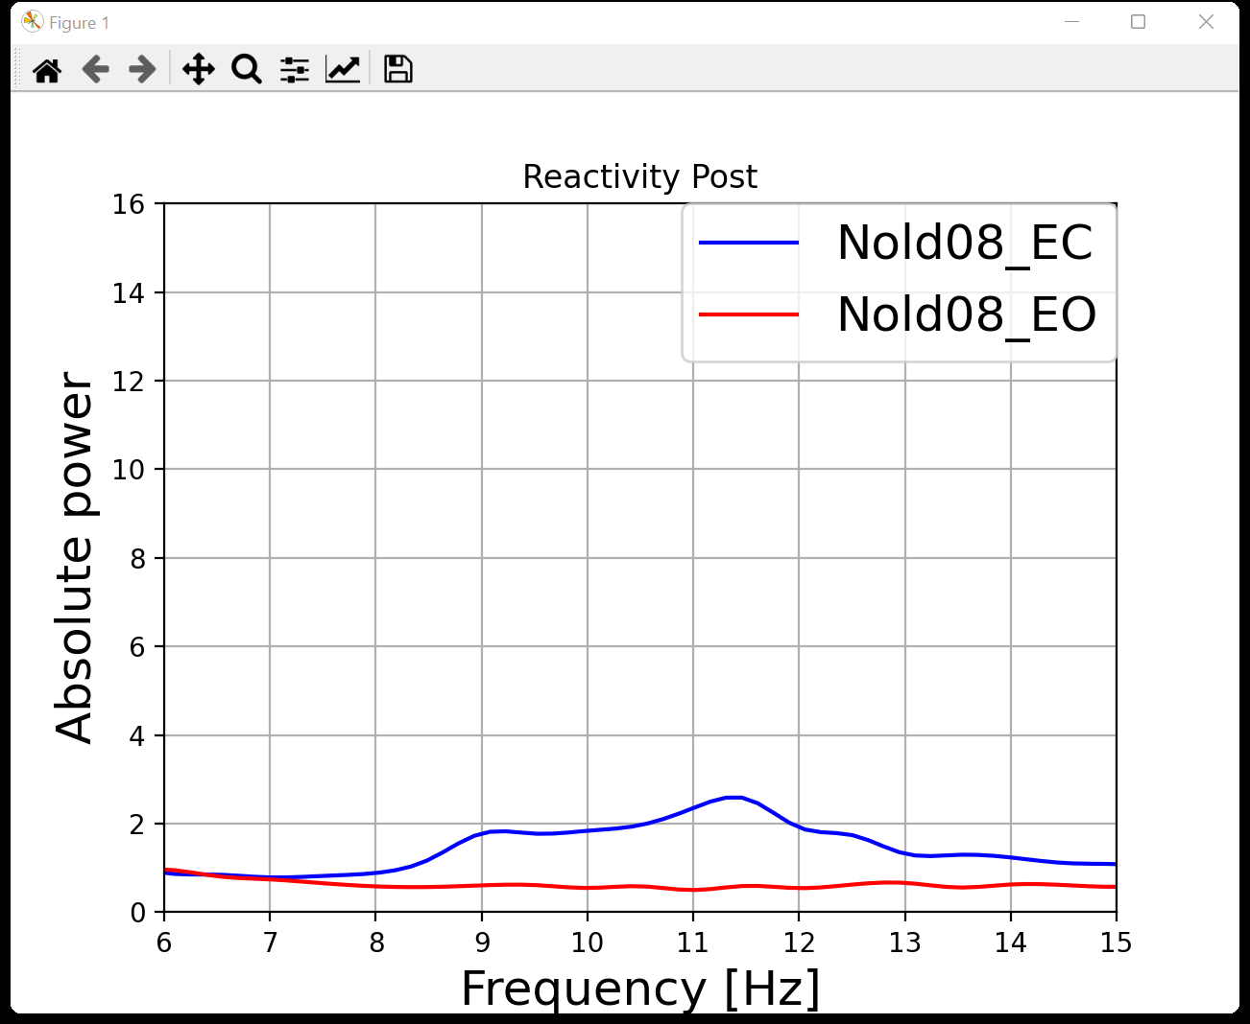
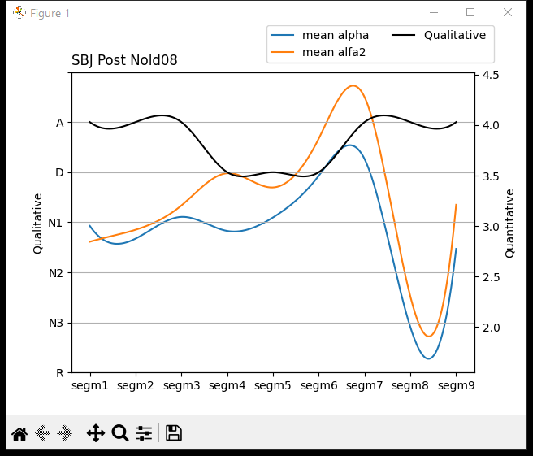
Nold08
CPO
TF | IAF
7 | 10
5,5 | 10,5
7 | 10,5
7,5 | 11,5
7 | 11
7 | 11
7,5 | 11
7,5 | 11
6,5 | 11
7 | 11
This graph represents the reactivity of the Nold08 subject taking the recording of the signal in the resting state.

Slide 13
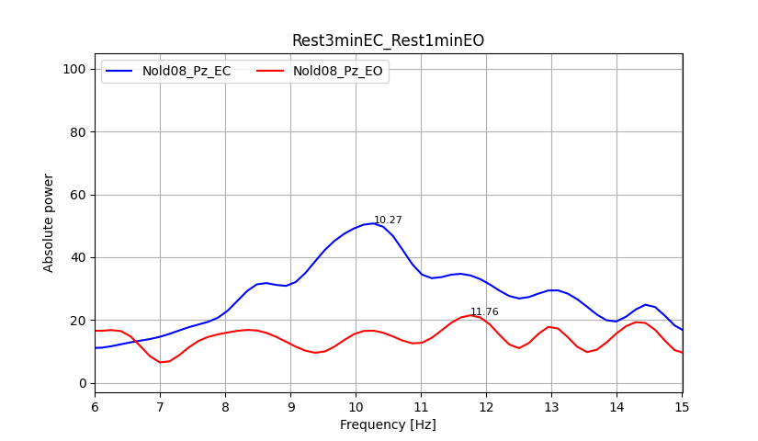
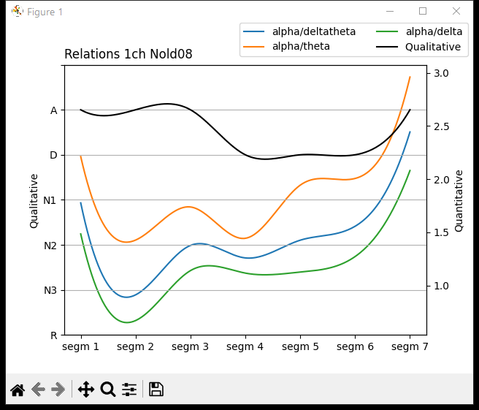
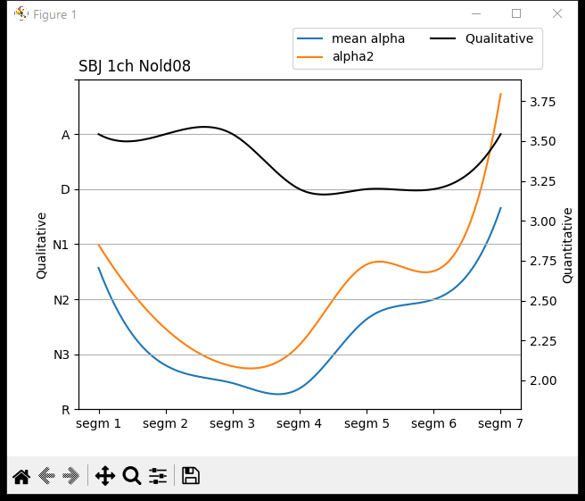
Nold08
This graph represents the channel with best reactivity of the Nold08 subject taking the signal recording in the resting state for eyes open and the signal recording in the resting state for eyes closed.

Slide 14
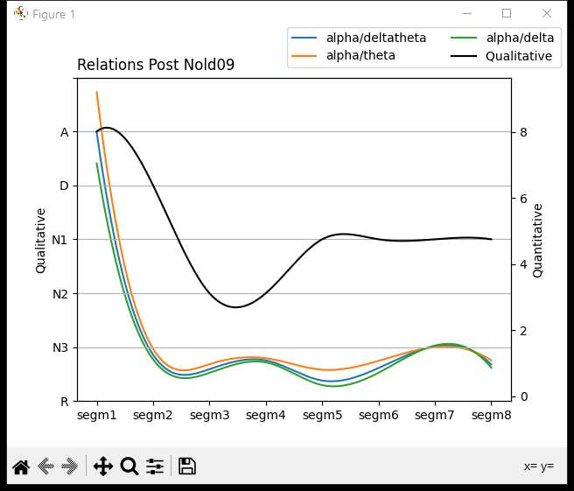
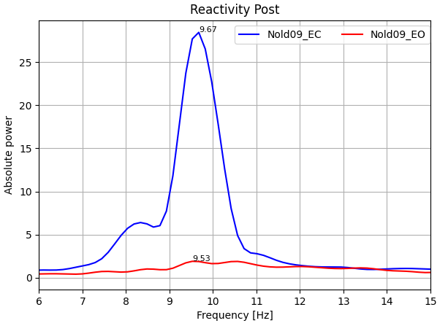
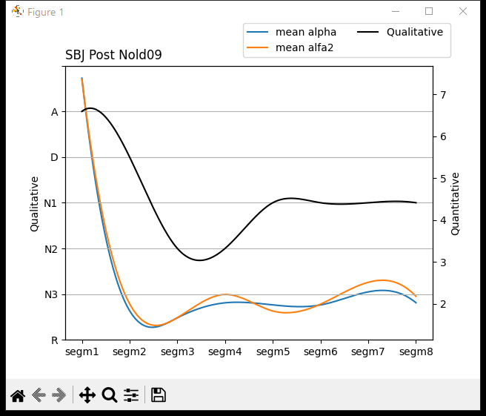
Nold09
CPO
This graph represents the reactivity of the Nold09 subject taking the recording of the signal in the resting state.

Slide 15
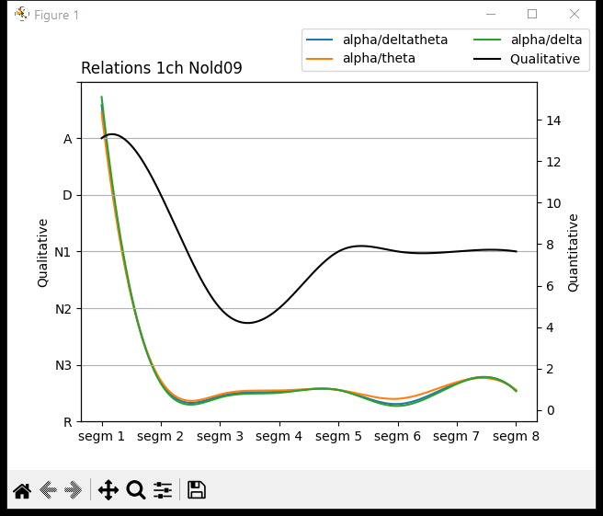
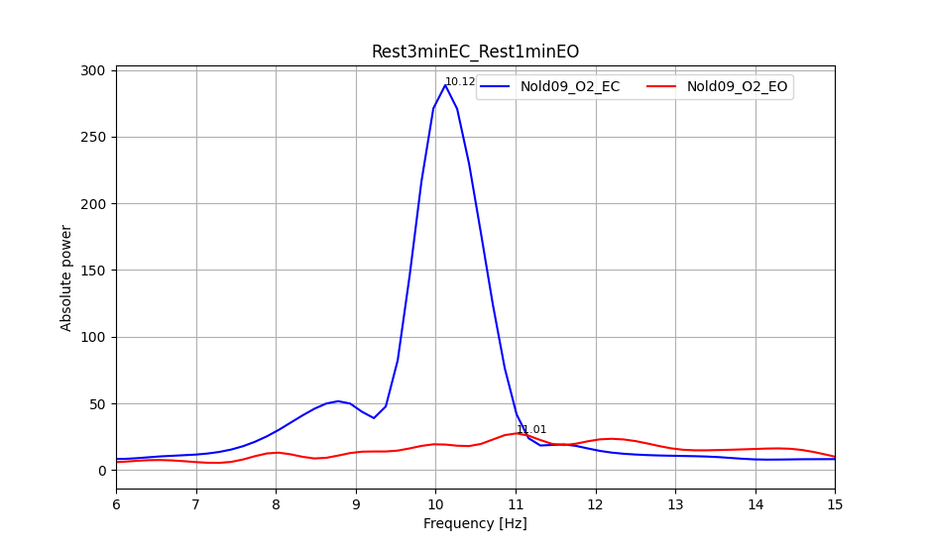
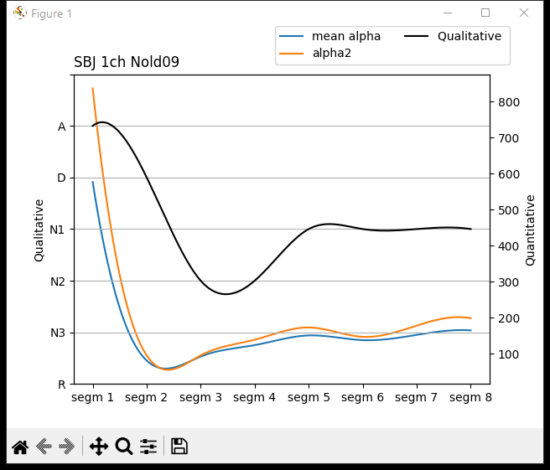
Nold09
This graph represents the channel with best reactivity of the Nold09 subject taking the signal recording in the resting state for eyes open and the signal recording in the resting state for eyes closed.

Slide 16
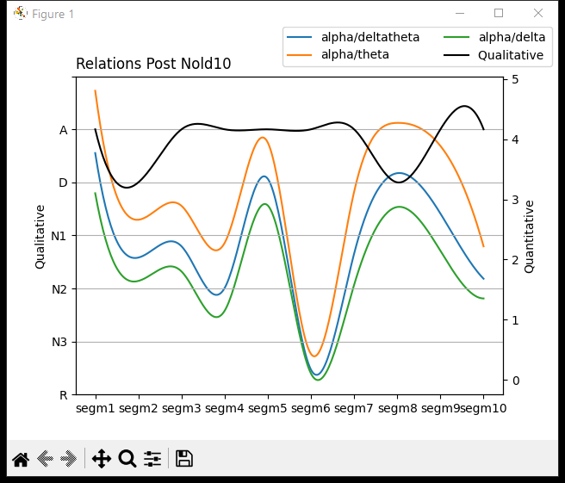
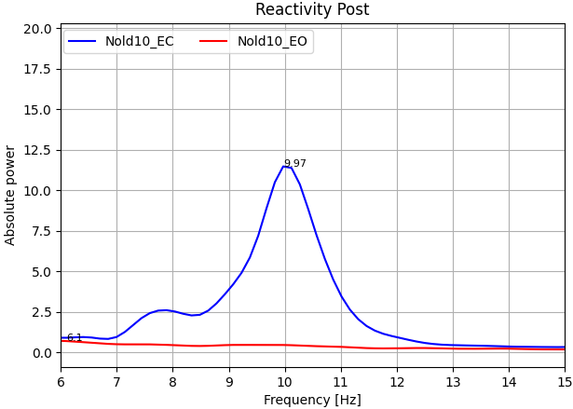
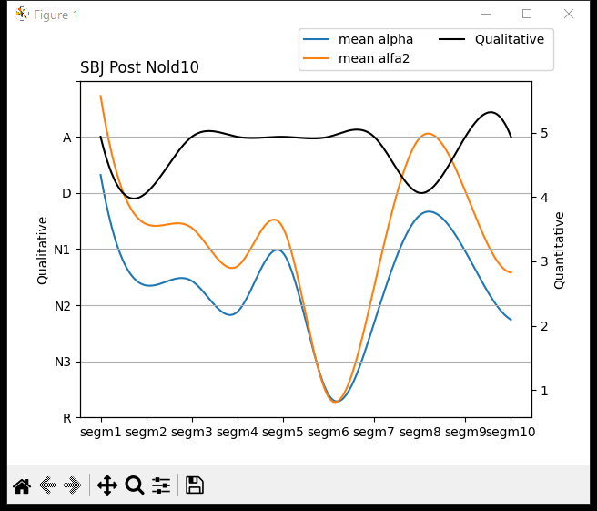
Nold10
CPO
This graph represents the reactivity of the Nold10 subject taking the recording of the signal in the resting state.

Slide 17
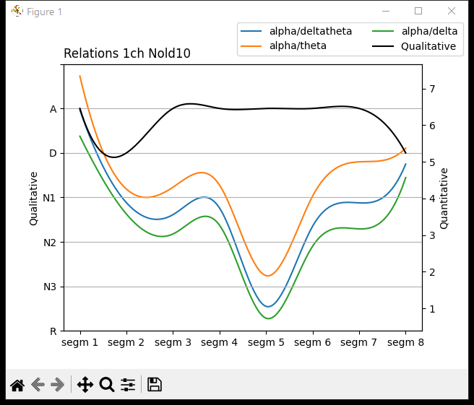
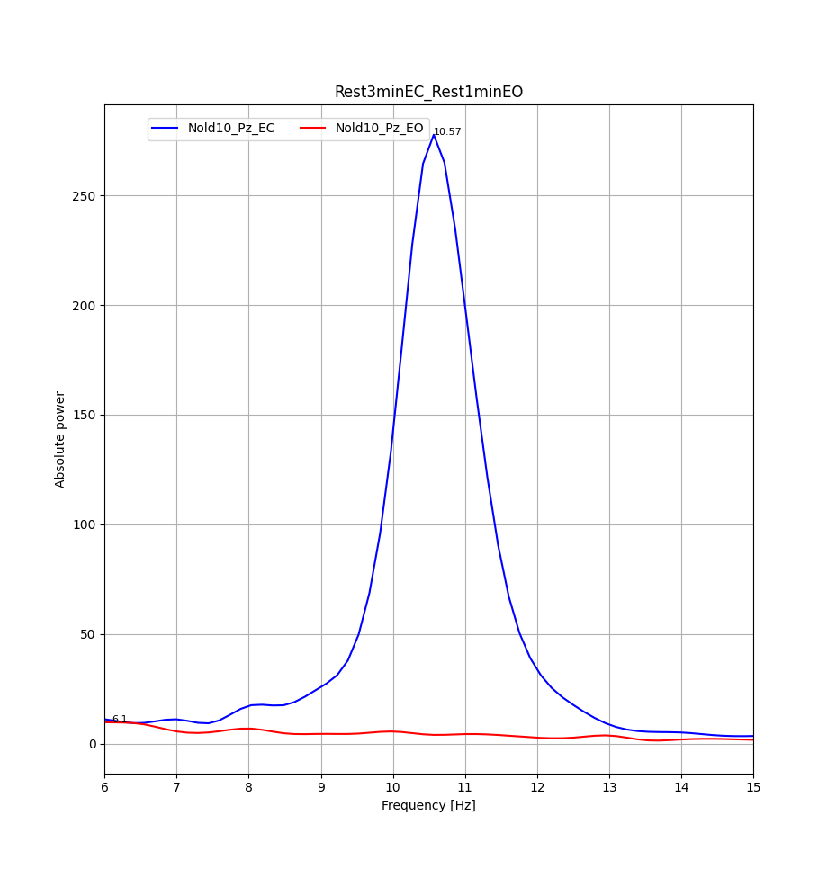
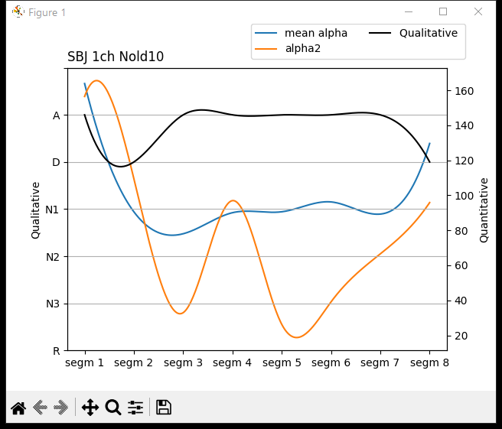
Nold10
This graph represents the channel with best reactivity of the Nold10 subject taking the signal recording in the resting state for eyes open and the signal recording in the resting state for eyes closed.

Slide 18
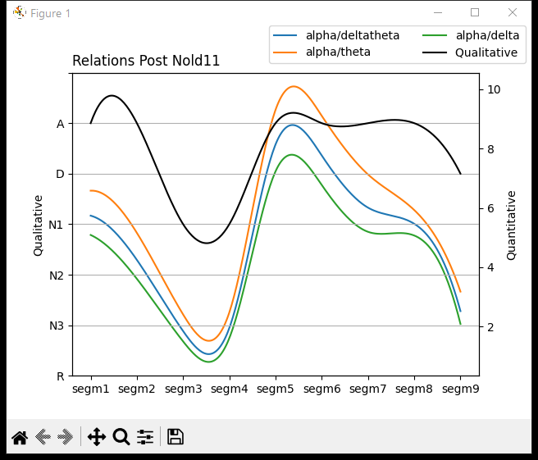
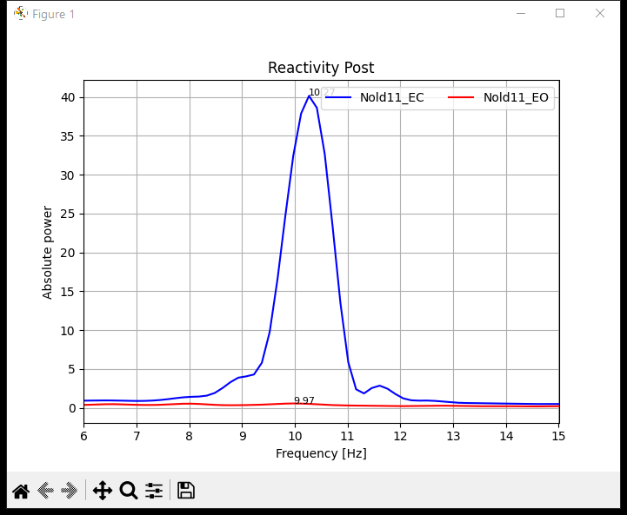
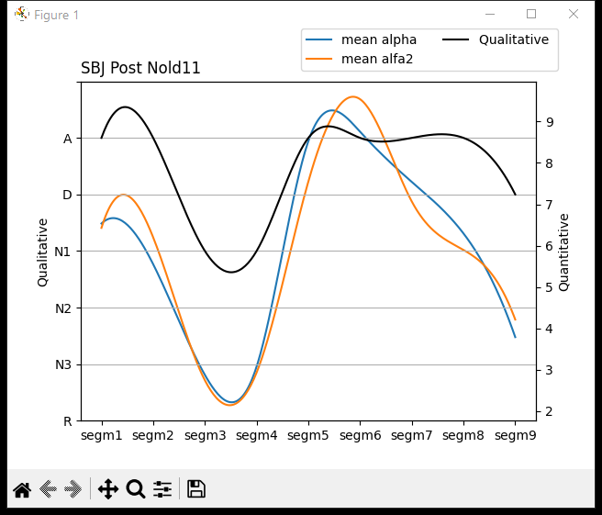
Nold11
CPO
This graph represents the channel with best reactivity of the Nold11 subject taking the signal recording in the resting state for eyes open and the signal recording in the resting state for eyes closed.

Slide 19
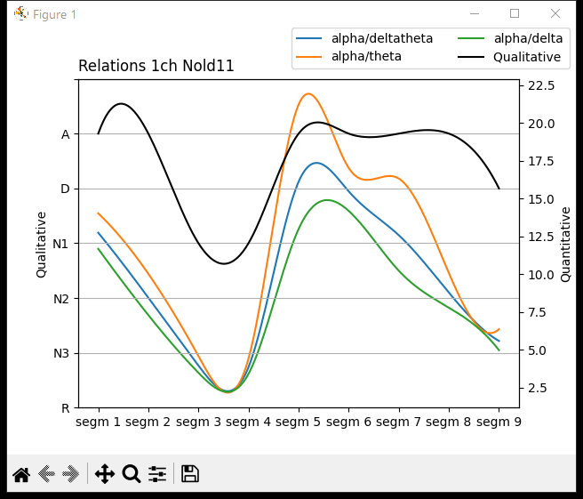


Nold11
This graph represents the channel with best reactivity of the Nold11 subject taking the signal recording in the resting state for eyes open and the signal recording in the resting state for eyes closed.

Slide 20


Nold11 (Wake01)
Time[60s](0:00-1:00)

Slide 21
Nold11 (Wake02)
Time[1s](14:00-15:00)

Slide 22
Nold11 (Ripples)
Time[0.5s](02:14-02:34)

Slide 23
Nold11 (DiffuseTheta)
Time[0.42s](09:20-09:45)

Slide 24
Nold11 (Vertex)
Time[0.38s](07:12-07:35)

Slide 25
Nold11 (DiffuseTheta +Vertex 01)
Time[0.33s](07:58-08:18)

Slide 26
Nold11 (DiffuseTheta +Vertex 02)
Time[0.5s](24:08-24:38)

Slide 28



Nold12
CPO
This graph represents the channel with best reactivity of the Nold12 subject taking the signal recording in the resting state for eyes open and the signal recording in the resting state for eyes closed.

Slide 29



Nold12
This graph represents the channel with best reactivity of the Nold12 subject taking the signal recording in the resting state for eyes open and the signal recording in the resting state for eyes closed.

Slide 30



Nold13
CPO
This graph represents the channel with best reactivity of the Nold13 subject taking the signal recording in the resting state for eyes open and the signal recording in the resting state for eyes closed.

Slide 31



Nold13
This graph represents the channel with best reactivity of the Nold13 subject taking the signal recording in the resting state for eyes open and the signal recording in the resting state for eyes closed.

Slide 32



Nold14
CPO
This graph represents the channel with best reactivity of the Nold14 subject taking the signal recording in the resting state for eyes open and the signal recording in the resting state for eyes closed.

Slide 33



Nold14
This graph represents the channel with best reactivity of the Nold14 subject taking the signal recording in the resting state for eyes open and the signal recording in the resting state for eyes closed.

Slide 34



Thessaloniki17
CPO
TF | IAF
5,5 | 8
6 | 7,5
5,5 | 6,5
5,5 | 6,5
4 | 8
4,5 | 11,5
5,5 | 8,5
This graph represents the reactivity of the Thessaloniki17 subject taking the recording of the signal in the resting state.

Slide 35



Thessaloniki17
This graph represents the channel with best reactivity of the Thessaloniki17 subject taking the signal recording in the resting state for eyes open and the signal recording in the resting state for eyes closed.

Slide 36



Brescia20
CPO
TF | IAF
5 | 8,5
5,5 | 11
5 | 11,5
5 | 8
6 | 8,5
5 | 7,5
4,5 | 7,5
6 | 7
This graph represents the reactivity of the Brescia20 subject taking the recording of the signal in the resting state.

Slide 37



Brescia20
This graph represents the channel with best reactivity of the Brescia20 subject taking the signal recording in the resting state for eyes open and the signal recording in the resting state for eyes closed.

Slide 38



Brescia23
CPO
TF | IAF
7 | 9
7 | 10
5,5 | 10,5
5,5 | 10,5
6 | 10,5
6 | 10,5
5,5 | 10,5
7 | 9,5
This graph represents the reactivity of the Brescia23 subject taking the recording of the signal in the resting state.

Slide 39



Brescia23
This graph represents the channel with best reactivity of the Brescia23 subject taking the signal recording in the resting state for eyes open and the signal recording in the resting state for eyes closed.

Slide 40



Genova02
CPO
TF | IAF
6,5 | 10
4 | 10
4 | 10
4 | 10
4,5 | 10
5,5 | 10
5,5 | 10
7 | 10
This graph represents the reactivity of the Genova02 subject taking the recording of the signal in the resting state.

Slide 41



Genova02
This graph represents the channel with best reactivity of the Genova02 subject taking the signal recording in the resting state for eyes open and the signal recording in the resting state for eyes closed.

Slide 42



Marseille01
CPO
TF | IAF
8 | 10
5 | 9,5
6,5 | 9
7,5 | 8
5,5 | 8
5,5 | 6,5
7 | 10
4 | 10,5
This graph represents the reactivity of the Marseille01 subject taking the recording of the signal in the resting state.

Slide 43



Marseille01
This graph represents the channel with best reactivity of the Marseille01 subject taking the signal recording in the resting state for eyes open and the signal recording in the resting state for eyes closed.

Slide 44



Marseille11
CPO
TF | IAF
4,5 | 9,5
4,5 | 7,5
4 | 7
5 | 7,5
4,5 | 6,5
4 | 7,5
3,5 | 8
4,5 | 7,5
4 | 7,5
4,5 | 7,5
4 | 8
This graph represents the reactivity of the Marseille11 subject taking the recording of the signal in the resting state.

Slide 45



Marseille11
This graph represents the channel with best reactivity of the Marseille11 subject taking the signal recording in the resting state for eyes open and the signal recording in the resting state for eyes closed.

Slide 46
Thessaloniki26
CPO
TF | IAF
6 | 10
6 | 10
6,5 | 10
7 | 9,5
6,5 | 9
5,5 | 10
5,5 | 10
5 | 10,5
7,5 | 9

Slide 47

Thessaloniki26
This graph represents the channel with best reactivity of the Thessaloniki26 subject taking the signal recording in the resting state for eyes open and the signal recording in the resting state for eyes closed.

Slide 48
Genova03
CPO
TF | IAF
4,5 | 8,5
4 | 9
5 | 9
5 | 9
4,5 | 9
4 | 8,5
4 | 9
5,5 | 9

Slide 49

Genova03
This graph represents the channel with best reactivity of the Genova03 subject taking the signal recording in the resting state for eyes open and the signal recording in the resting state for eyes closed.

Slide 50

Brescia33
CPO
This graph represents the reactivity of the Brescia33 subject taking the recording of the signal in the resting state.

Slide 51

Brescia33
This graph represents the channel with best reactivity of the Brescia33 subject taking the signal recording in the resting state for eyes open and the signal recording in the resting state for eyes closed.

Slide 52

Genova05
CPO
This graph represents the reactivity of the Genova05 subject taking the recording of the signal in the resting state.

Slide 53

Genova05
This graph represents the channel with best reactivity of the Genova05 subject taking the signal recording in the resting state for eyes open and the signal recording in the resting state for eyes closed.

Slide 54

Leipzig01
CPO
This graph represents the reactivity of the Leipzig01 subject taking the recording of the signal in the resting state.

Slide 55

Leipzig01
This graph represents the channel with best reactivity of the Leipzig01 subject taking the signal recording in the resting state for eyes open and the signal recording in the resting state for eyes closed.

Slide 56

Marseille07
CPO
This graph represents the reactivity of the Marseille07 subject taking the recording of the signal in the resting state.

Slide 57

Marseille07
This graph represents the channel with best reactivity of the Marseille07 subject taking the signal recording in the resting state for eyes open and the signal recording in the resting state for eyes closed.

Slide 58

Toulose05
CPO
This graph represents the reactivity of the Toulose05 subject taking the recording of the signal in the resting state.

Slide 59

Toulose05
This graph represents the channel with best reactivity of the Toulose05 subject taking the signal recording in the resting state for eyes open and the signal recording in the resting state for eyes closed.

